Slide 1
EP003
EPIC:
As a BMW prospect with Existing Easy Finance Account I should be able to Login via an APP for BMW Easy Finance.

Slide 2
EP003: Login
Story ID: EP003-S004-PK:
As a Existing User to BMW Easy Finance APP I should be able to Login with password successfully.
Story ID: EP003-S005-PK :
As a Existing User to BMW Easy Finance APP I should be able to Login with temp. PWD(OTP) successfully.
Story ID: EP003-S006-PK :
As a Existing User of Easy Finance Application When I forget my password I should be allowed to login by resetting my password.

Slide 3
Story ID: EP003-S004-PK:
Business
Legal
As a Existing User to BMW Easy Finance APP I should be able to Login with password successfully.
Assumptions:
Customer is at the dealership; Customer has already downloaded & Registered; User have a BMW Web (GCDM) Account;
Easy Finance APP user Authorization & Authentication works with COP/GCDM;
Pre-Conditions:
Customer has Registered for BMW account using COP/GCDM Registration service and has set password for registration.
SMS Trigger is used if customer forgets the password.
Customer should have most up to date easy finance APP installed and accessible with internet connection.
Acceptance Criteria:
Customer Starts Easy Finance App and Selects login.
From the Login page Customer Selects “Login with PWD”
Customer enters the user name and password.
Customer is prompted with Error if username and password do not match.
Customer is re-directed to main page if he is successfully Logged in.
Security
Compliance

Slide 4
Story ID: EP003-S005-PK:
Business
Legal
As a Existing User to BMW Easy Finance APP I should be able to Login with temp. PWD(OTP) successfully.
Assumptions:
Customer is at the dealership; Customer has already downloaded & Registered; User have a BMW Web (GCDM) Account;
Easy Finance APP User Authorization & Authentication works with COP/GCDM;
Pre-Conditions:
Customer has Registered for BMW account using COP/GCDM Registration service and has NOT SET the password for his account.
SMS Trigger is used if customer forgets the password.
Customer should have most up to date easy finance APP installed and accessible with internet connection.
Acceptance Criteria:
Customer Starts Easy Finance App and Selects login.
From the Login page Customer Selects “Login with PIN”
Customer enters the user name and request for OTP (One Time Password).
Timmer starts to warn the customer with .
Customer is re-directed to main page if he is successfully Logged in.
Security
Compliance

Slide 5
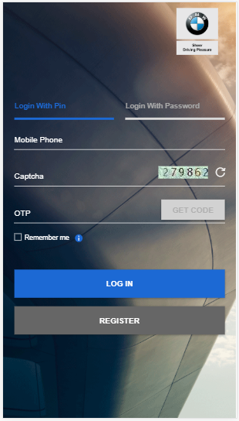
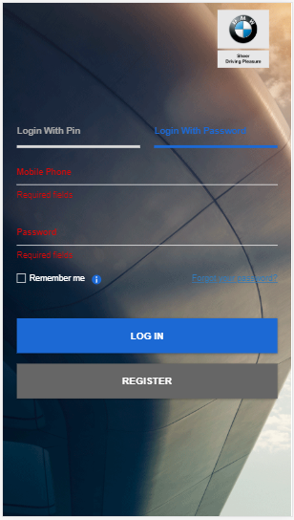
Story ID: EP003-S004-PK & EP003-S005-PK:
Mockups:
BMW Financial Services
Welcome!
App Introduction goes here,
Helpline: XX-XXXX-XXX
BMW Financial Services
Welcome!
Please Click here to understand our Application Process,
Helpline: XX-XXXX-XXX
Check Application Status
Create New Application.
Cancel & Goto Main Page
Login
Registration

Slide 6
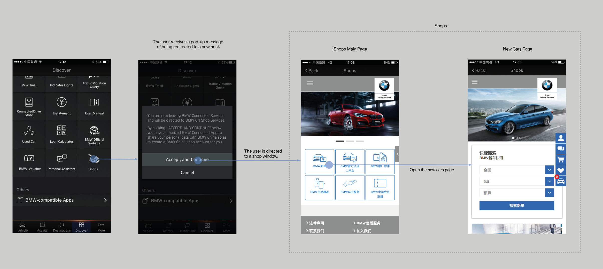
Story ID: EP003-S004-PK & EP003-S005-PK:
Wireframes
Sample

Slide 7
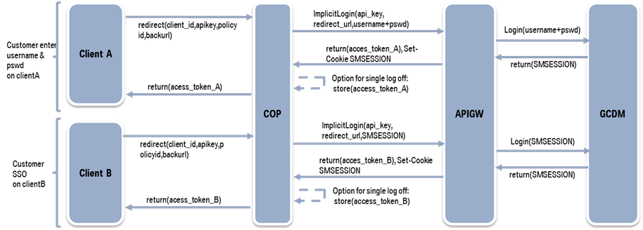
Story ID: EP003-S004-PK & EP003-S005-PK:
Process Flow:
Easy Finance APP
Registration
Process

Slide 8
Story ID: EP003-S004-PK & EP003-S005-PK:
Sequence Flow
EF APP FE
EF Service BE
COP
APIGW
GCDM
Redirect
(Client_ID, APIKey, PolicyID, BackURL)
Implicit Reg. (APIKey,
Redirect url, Usrname+pwd
Push Data to GCDM
& Create BuPa
COP Passes Successful/Failed
Registration to EF APP & Pass Token
Return (access_token_A),
Set Cookies SMSESSION
Return Success/Failure
Status to API GW
Send the Token to EF Service Backend
Pass the token to GCDM API GATEWAY To get validated
Validate and fetch the
data from GCDM DB
Profile Data Returned
Return the Profile Data
Send Success & redirect the customer to APP Main page
Create a Local Copy
If the user already
don’t exist & Store in EF DB.

Slide 9
Story ID: EP003-S006-PK
Business
Legal
As a Existing User of Easy Finance Application When i trying to Register with Easy Application Finance,
I should be prompted to login.
Assumptions:
User is at the dealership; APP is not published to APP Store; User have a Existing BMW Web (GCDM) Account;
Easy Finance APP to integrate with COP/GCDM;
Pre-Conditions:
Customer can only Download the SF’s Easy Finance APP from the dealership using QR Code shared by the dealer.
APP is Privately hosted and maintained by BMW Financial services.
GCDM Integration for APP user Profile Creation and Management. User Trying to register has/had a Existing BMW GCDM Account.
SMS Trigger is Used for Mobile No. Verification.
Acceptance Criteria:
When the app is downloaded and started, Customer is Prompted with Welcome Page Registration or Login Button
If & when Customer Tap on Registration button from the APP Customer is directed to Registration Page – Possible COP Integration.
Customer Mobile no., Name is Mandatory, since Customer selected “Register with PIN” Customer is not given with option to set PWD.
Customer Accepts T&C before tapping on send verification code to mobile.
When the customer tap’s Send Verification code, COP/GCDM Check the GCDM DB and prompts Customer with message saying “ It looks like you already have an account for BMW” – please login with your BMW Web Account.
Will be handled by COP page if integrated with COP/GCDM.
Security
Compliance

